Slide 1

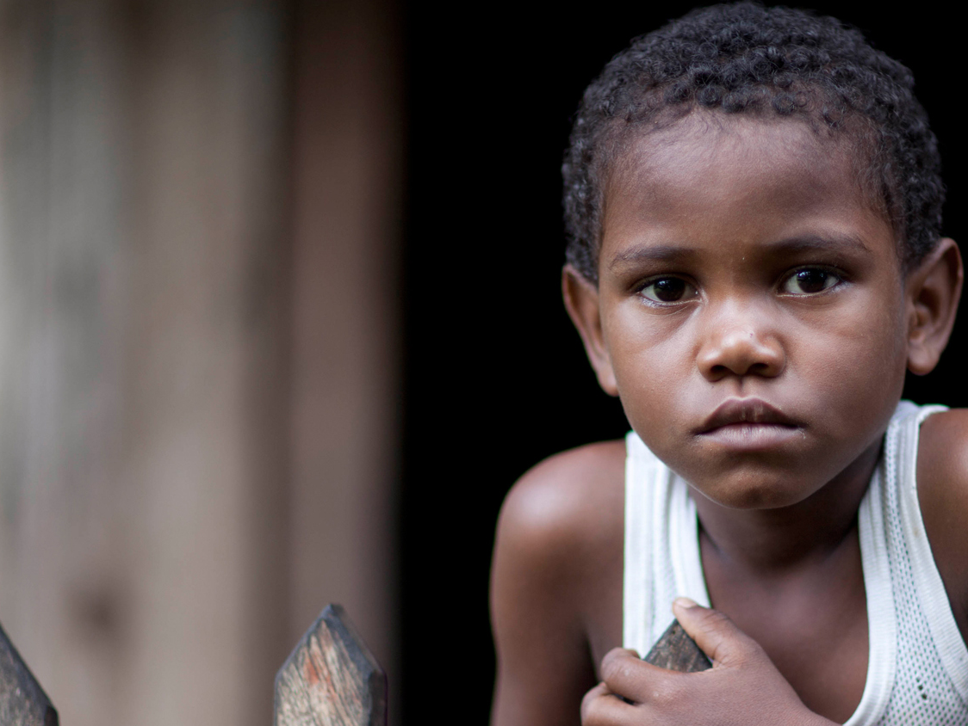
CONTENT SLIDE – Full image
Community Rapid Assessment – Uganda 1st Round
All Available Visualizations
UNICEF EO ILU

Slide 2
Community Rapid Assessment - Uganda 1st Round All Available Visualizations
Deliverable Note
This deliverable includes all available visualizations for the first round of the CRA study in Uganda.
It is included on this PPT all national distributions of the questions, as well as demographics crossings on Rural/Urban Setting, Education, Age, and Language.
The data purpose is to make available visualizations for the country office to use as necessary on other documents.
This deliverable accompanies a shorter PPT with highlights to note for the round.
To facilitate visualization and printing out of the output from the original script each visualization occupies one slide. If needed, the visualization can be directly modified by request or from the script provided on each delivery.
2
2
UNICEF – for every child

Slide 3
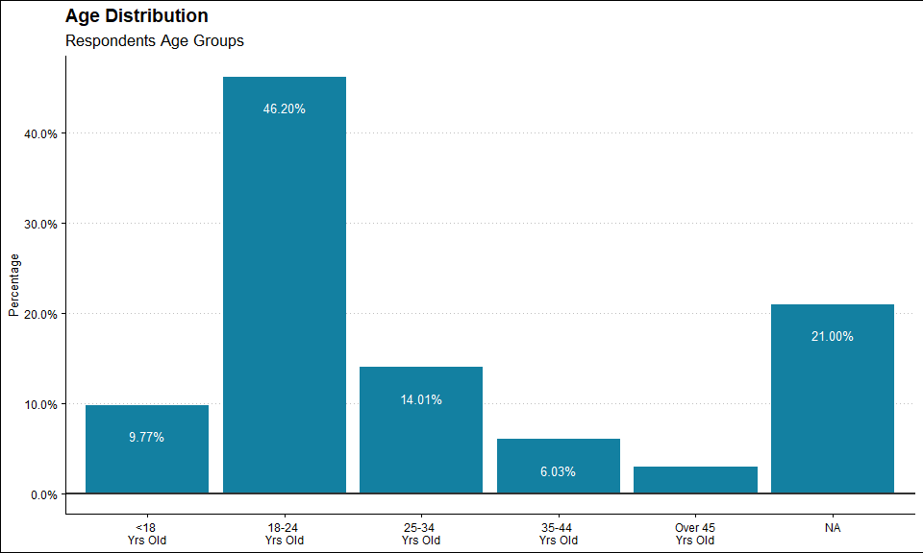
3
UNICEF – for every child

Slide 4
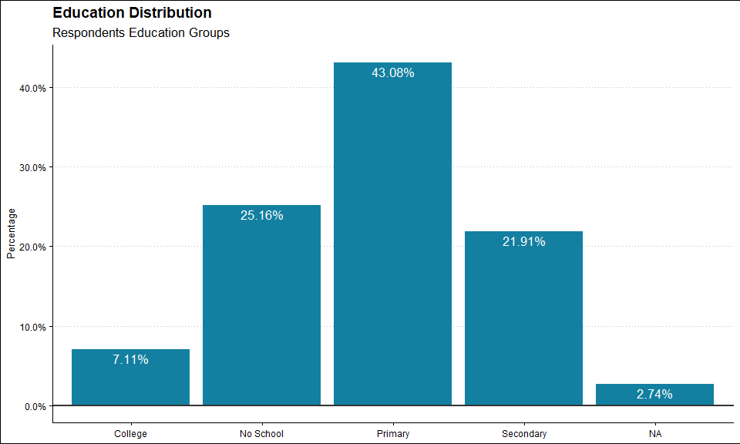
4
UNICEF – for every child

Slide 5
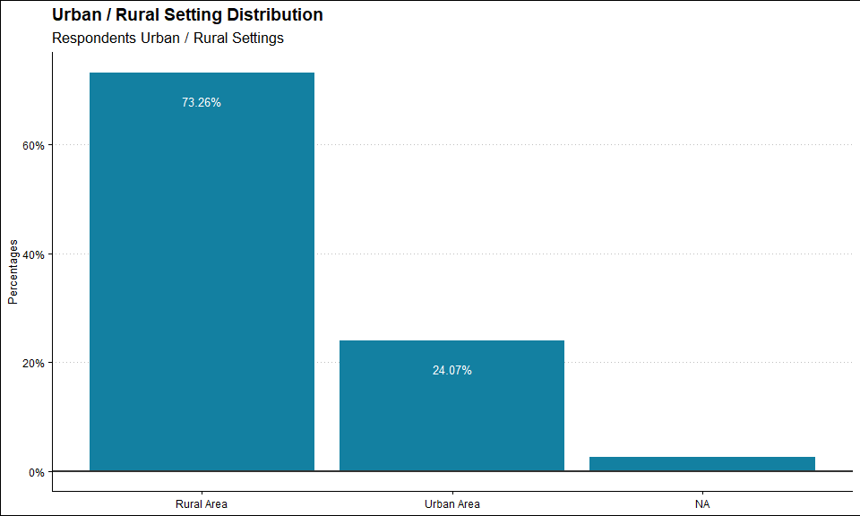
5
UNICEF – for every child

Slide 6
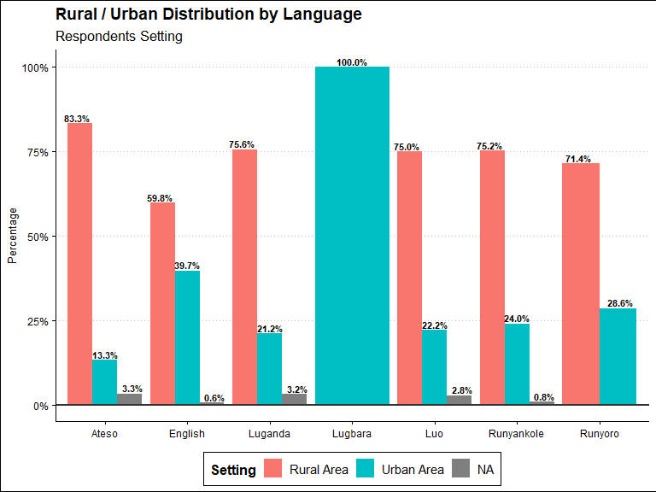
6
UNICEF – for every child

Slide 7
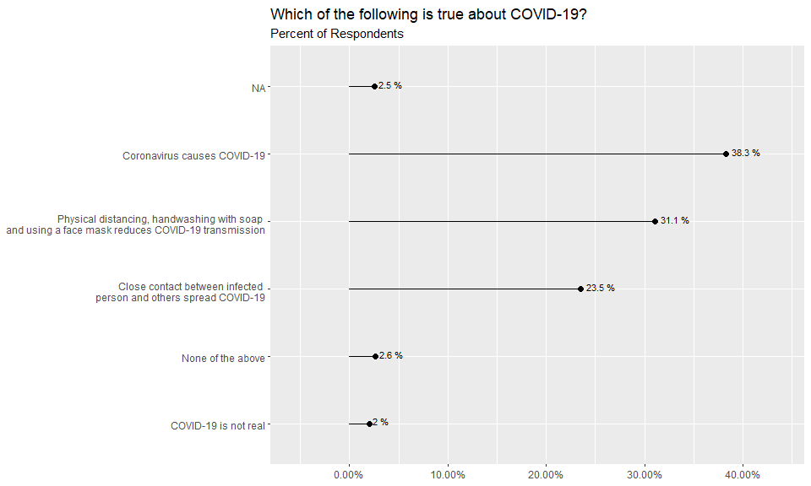
7
UNICEF – for every child

Slide 8
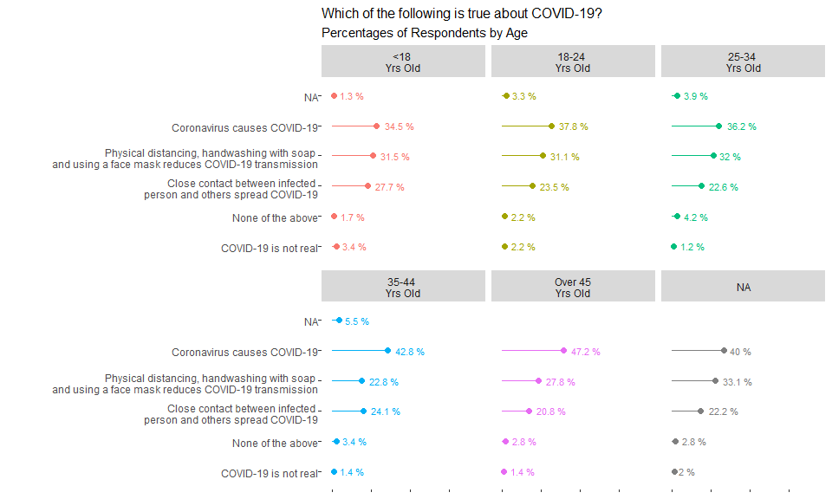
8
UNICEF – for every child

Slide 9
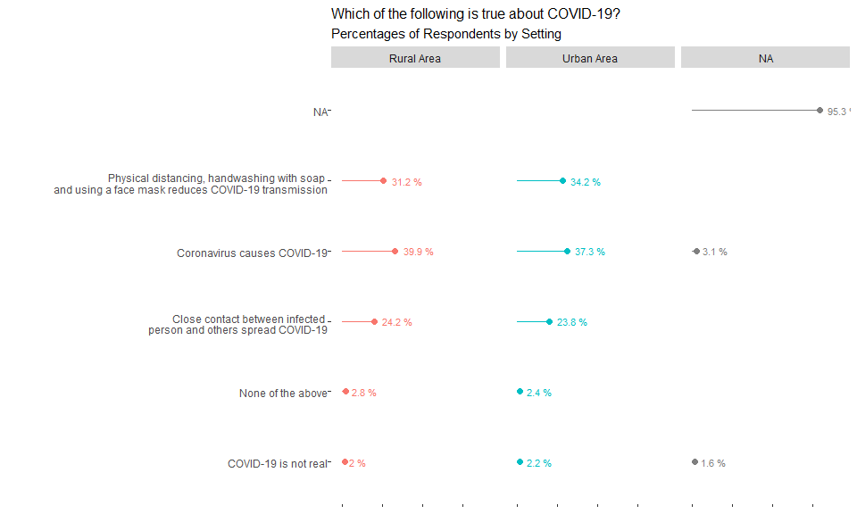
9
UNICEF – for every child

Slide 10
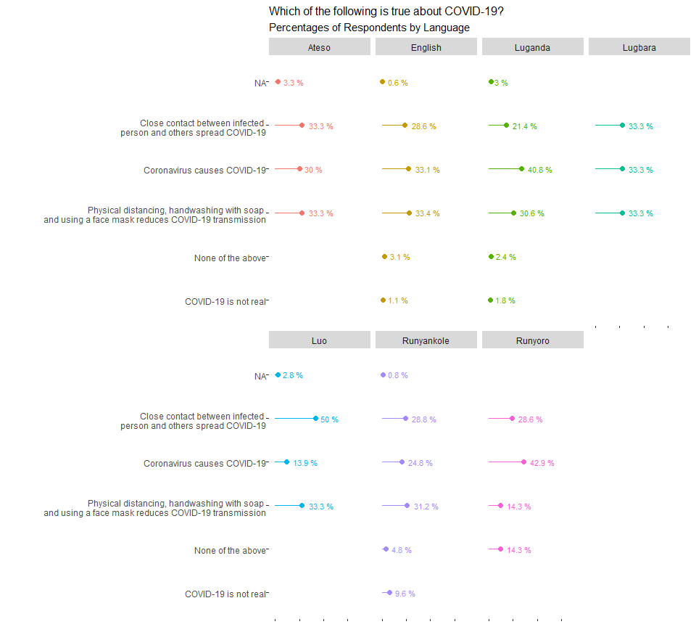
10
UNICEF – for every child

Slide 11
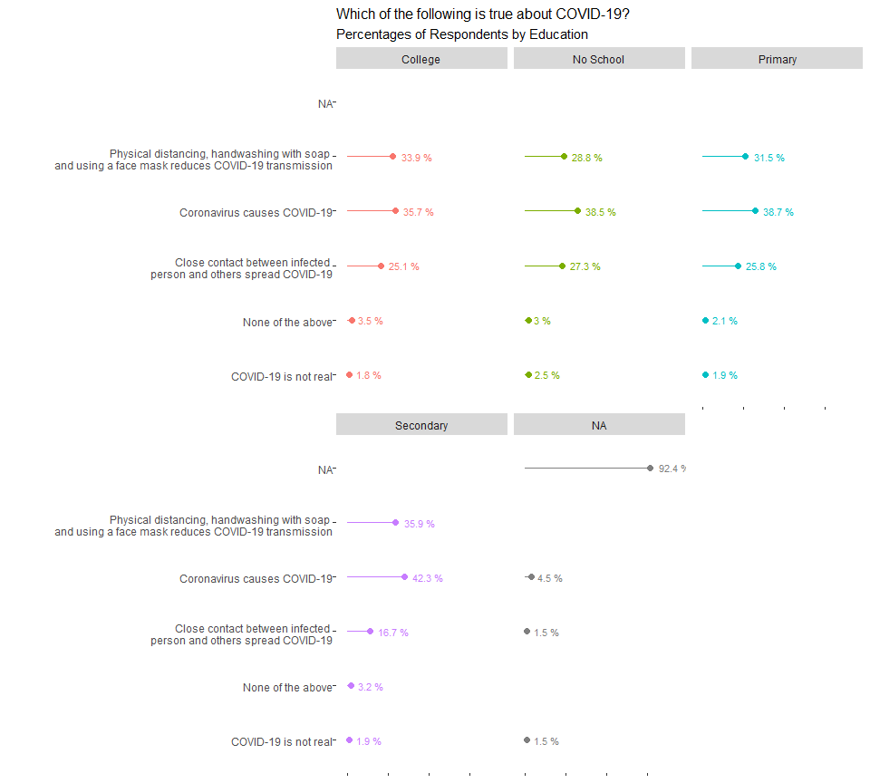
11
UNICEF – for every child

Slide 12
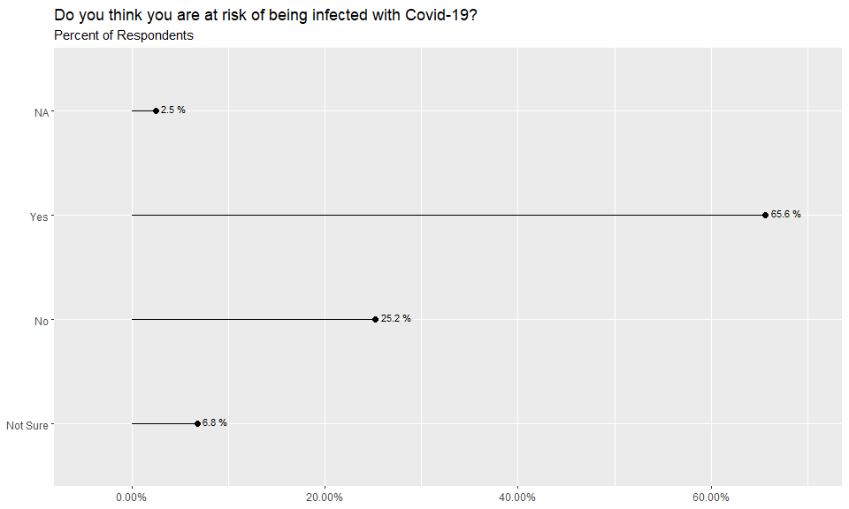
12
UNICEF – for every child

Slide 13
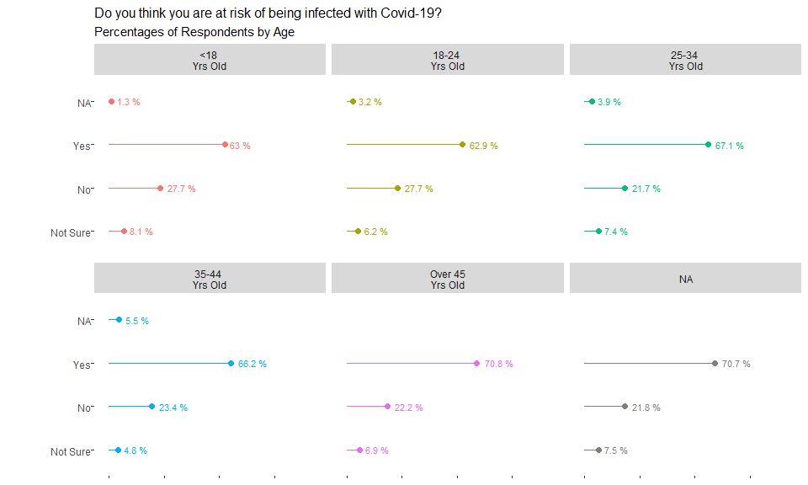
13
UNICEF – for every child

Slide 14
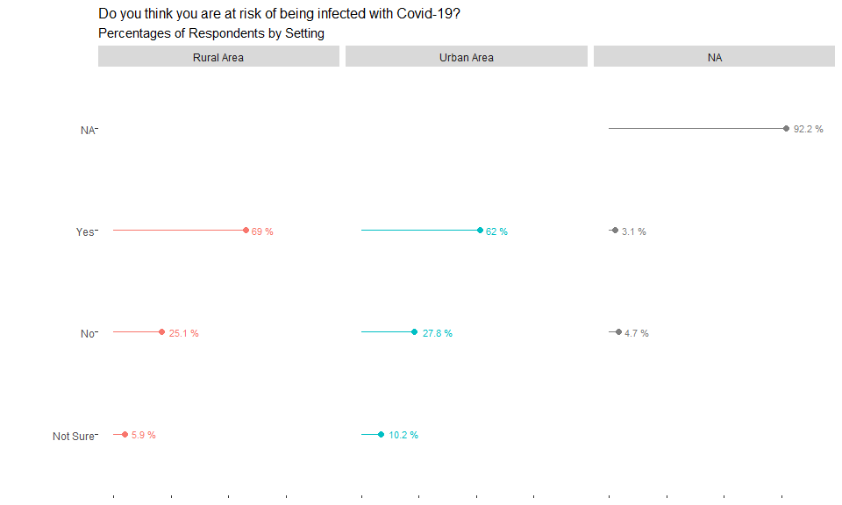
14
UNICEF – for every child

Slide 15
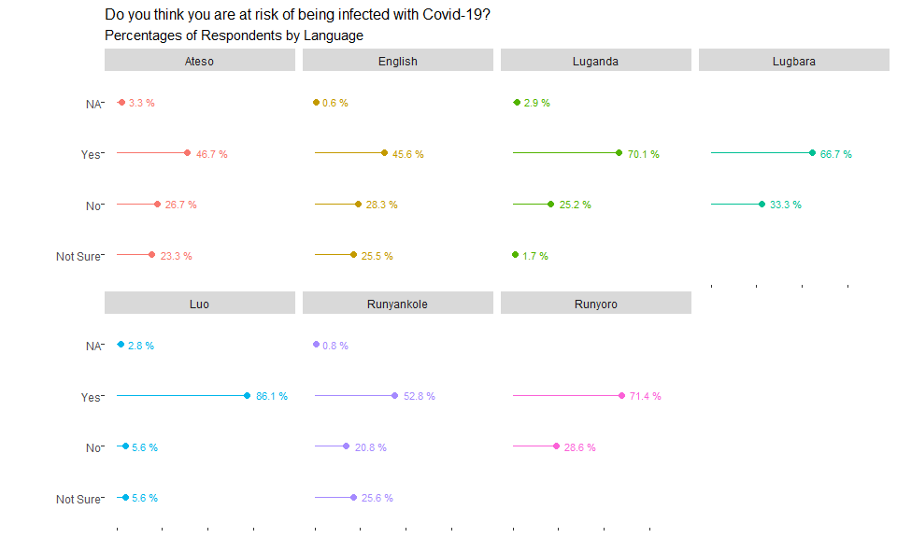
15
UNICEF – for every child

Slide 16
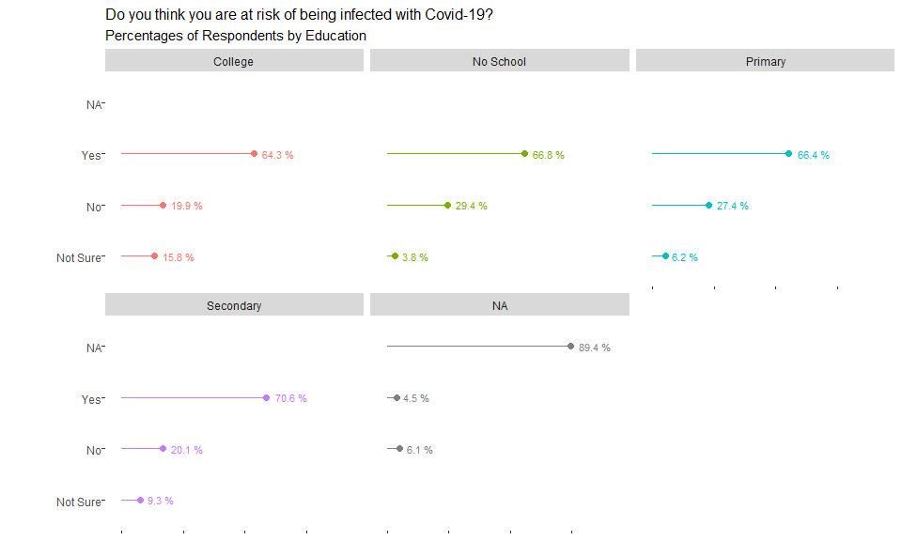
16
UNICEF – for every child

Slide 17
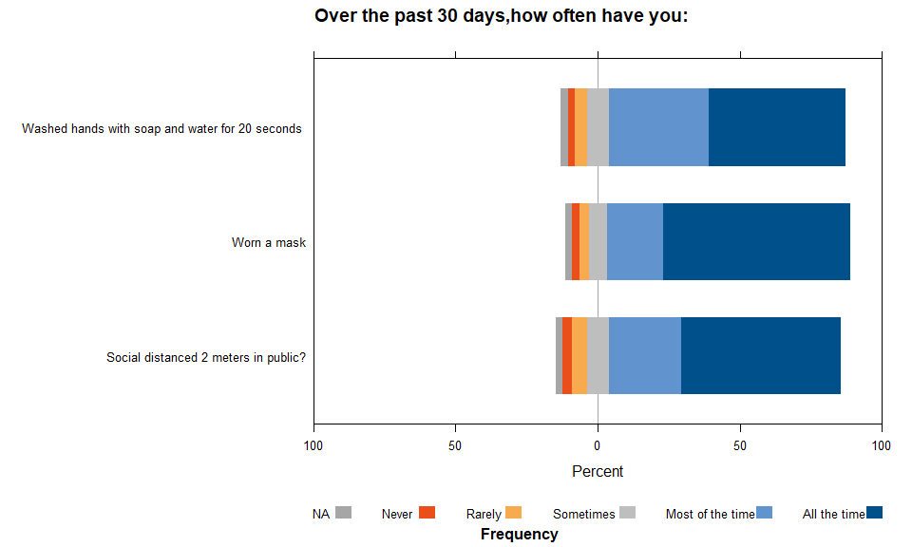
17
UNICEF – for every child

Slide 18
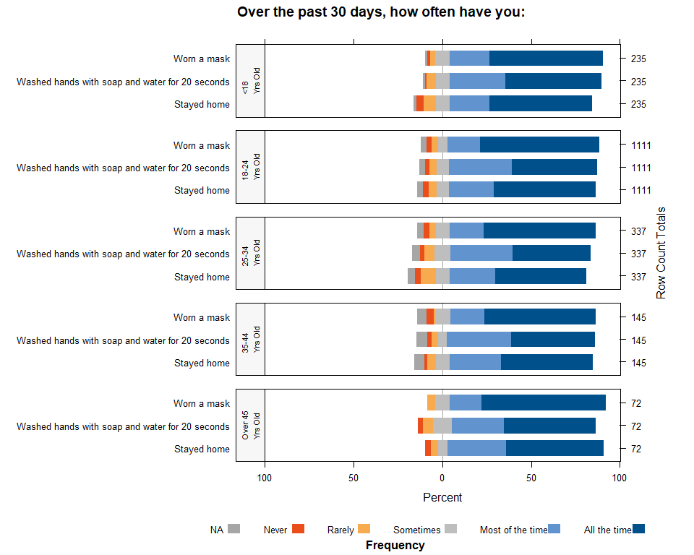
18
UNICEF – for every child

Slide 19
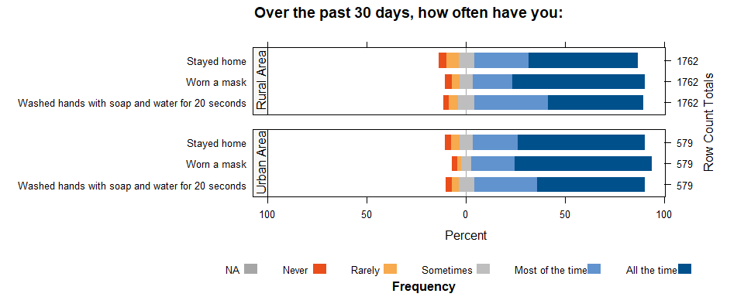
19
UNICEF – for every child

Slide 20
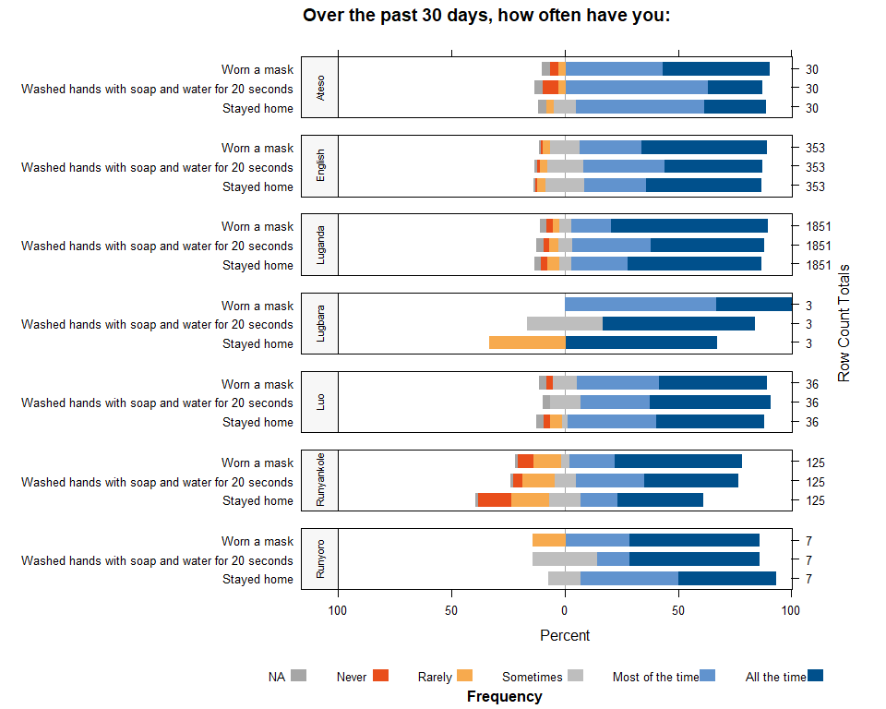
20
UNICEF – for every child

Slide 21
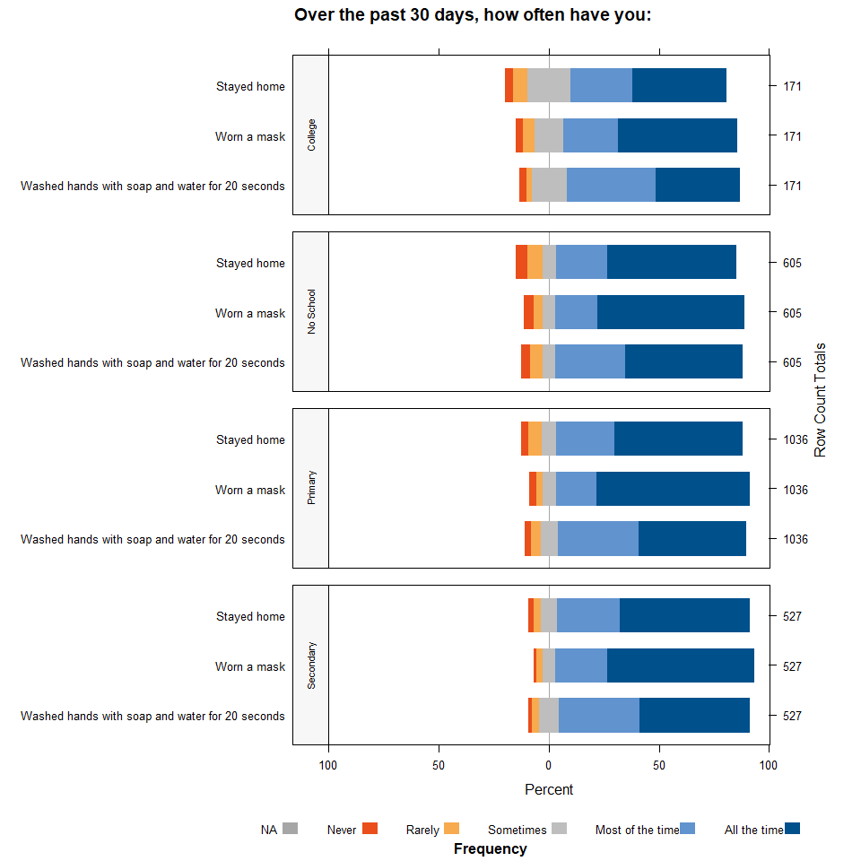
21
UNICEF – for every child

Slide 22
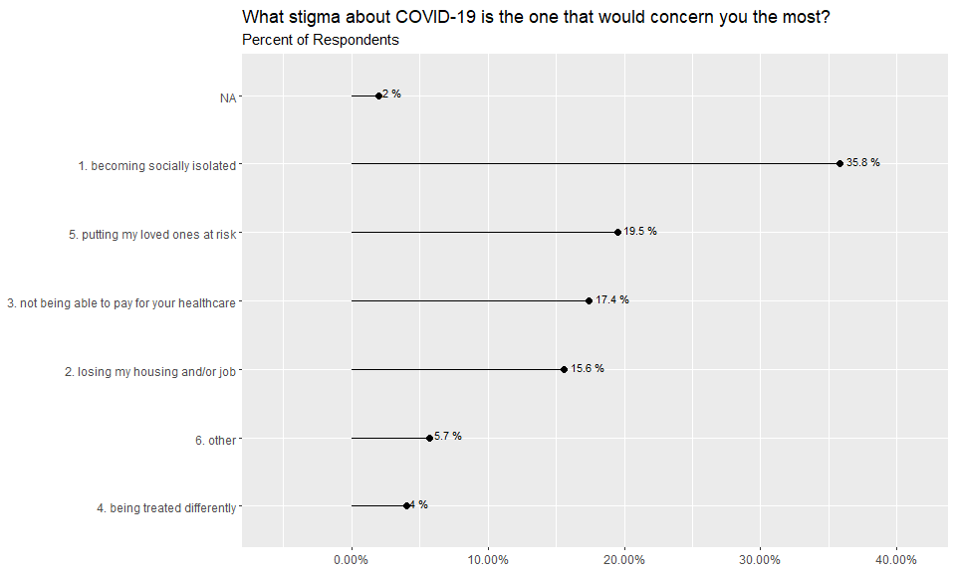
22
UNICEF – for every child

Slide 23
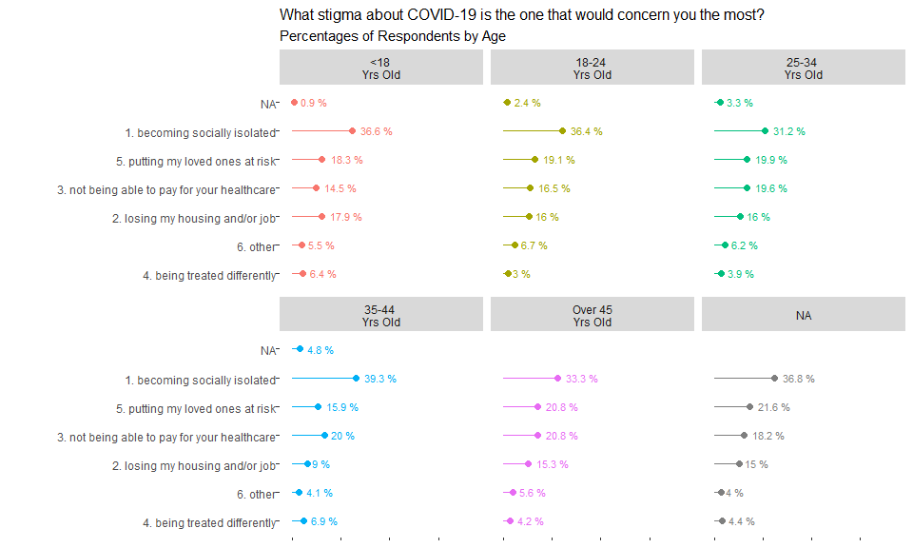
23
UNICEF – for every child

Slide 24
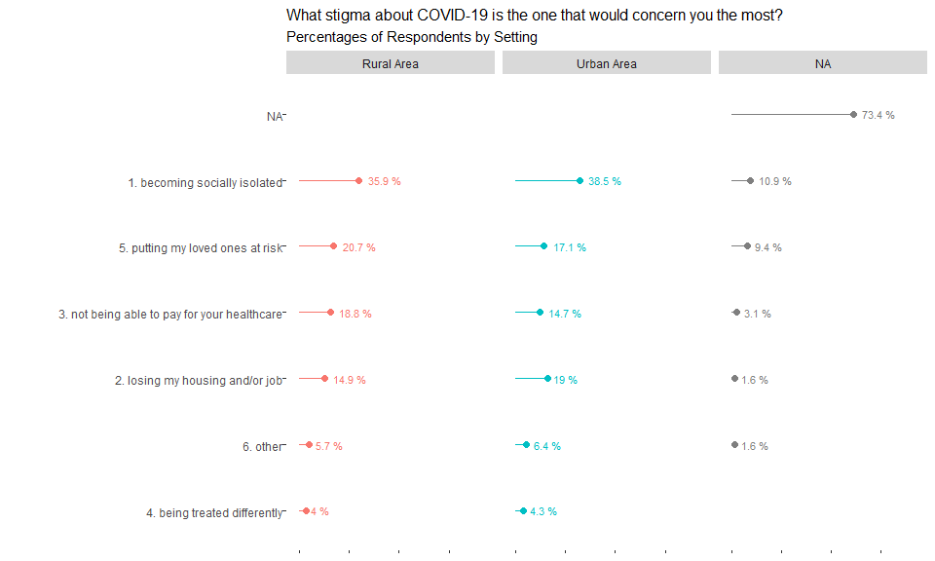
24
UNICEF – for every child

Slide 25
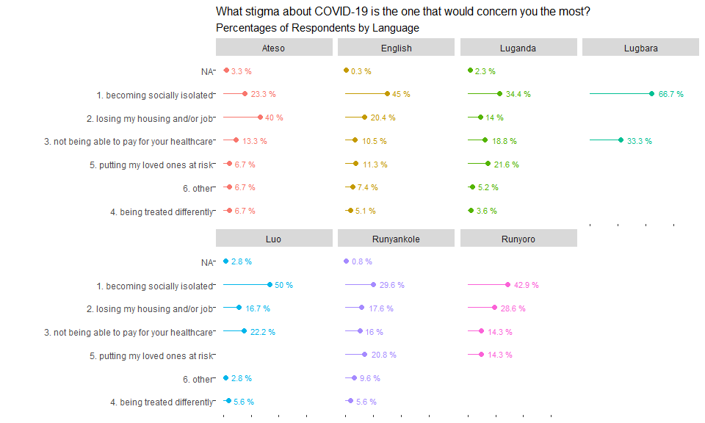
25
UNICEF – for every child

Slide 26
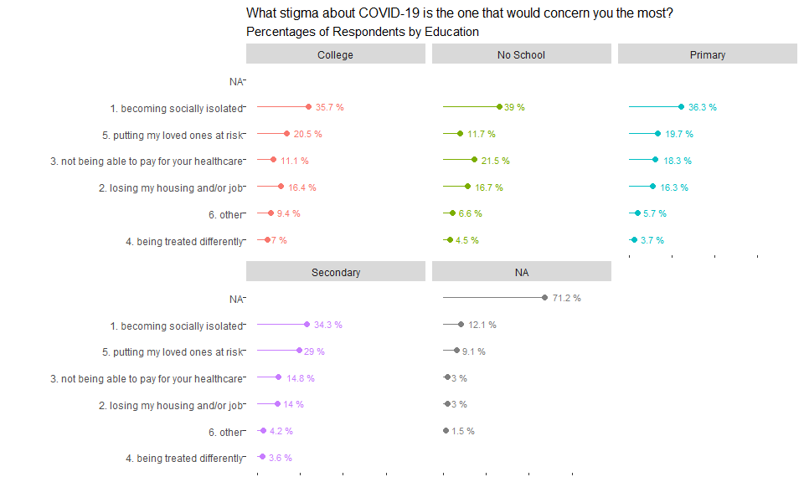
26
UNICEF – for every child

Slide 27
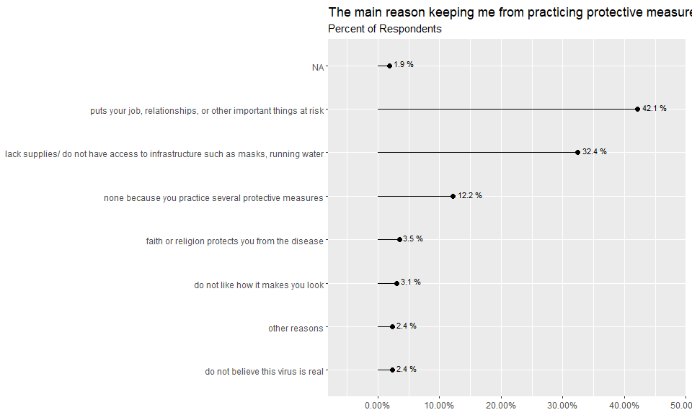
27
UNICEF – for every child

Slide 28
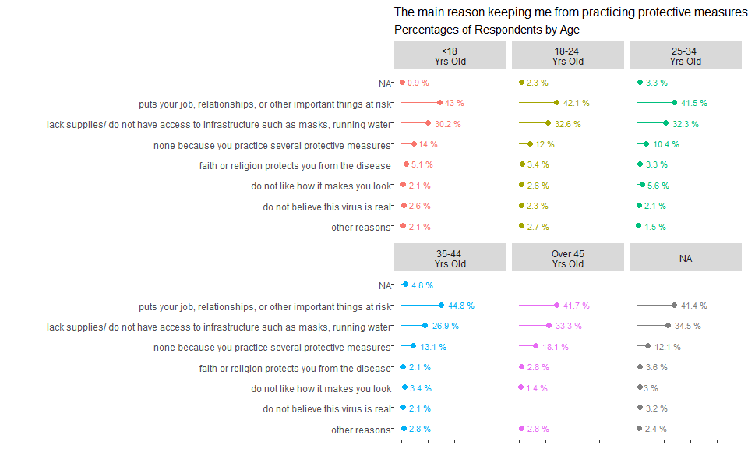
28
UNICEF – for every child

Slide 29
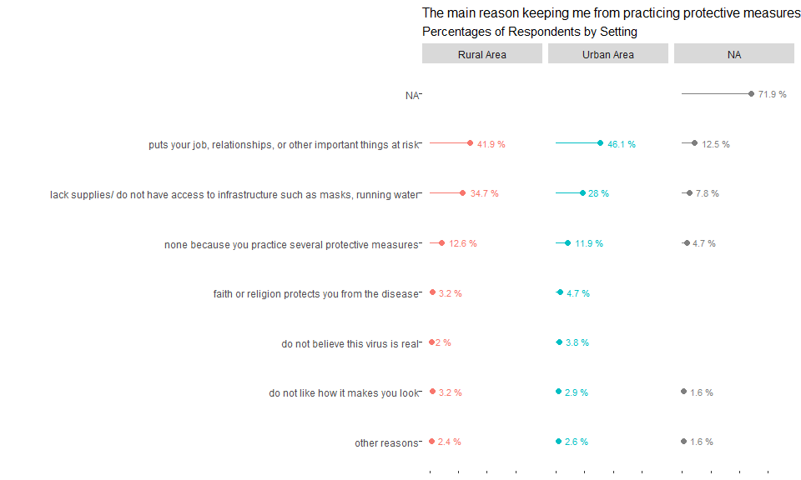
29
UNICEF – for every child

Slide 30
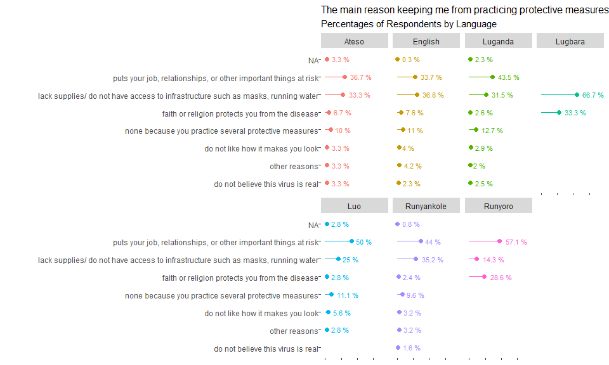
30
UNICEF – for every child

Slide 31
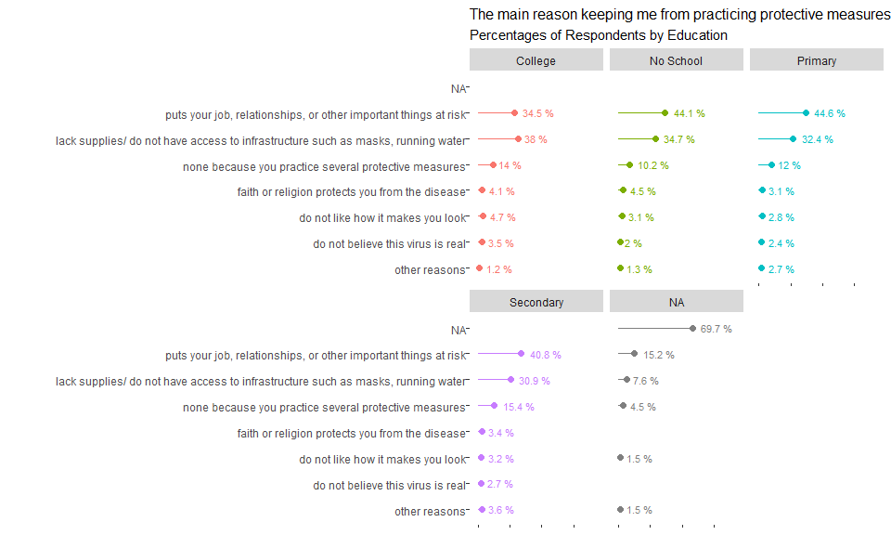
31
UNICEF – for every child

Slide 32
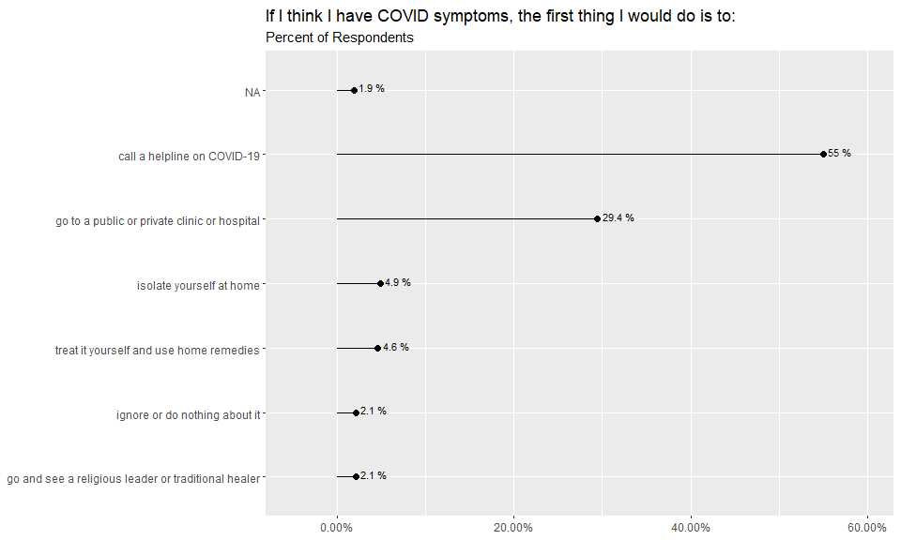
32
UNICEF – for every child

Slide 33
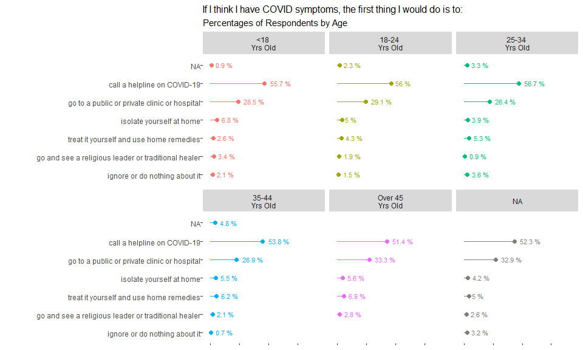
33
UNICEF – for every child

Slide 34
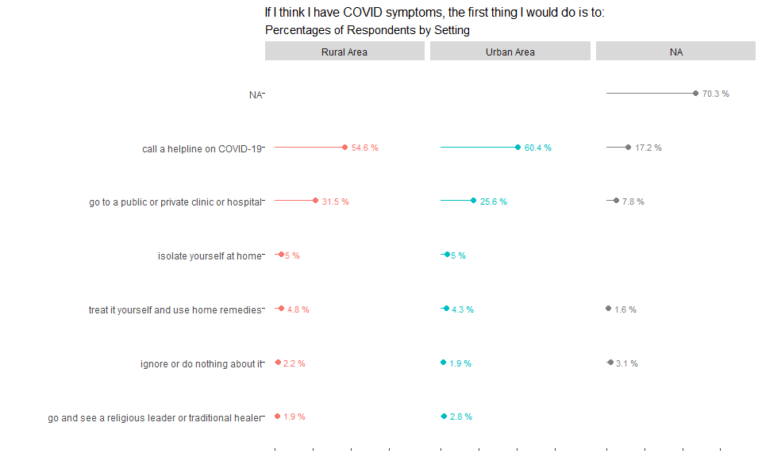
34
UNICEF – for every child

Slide 35
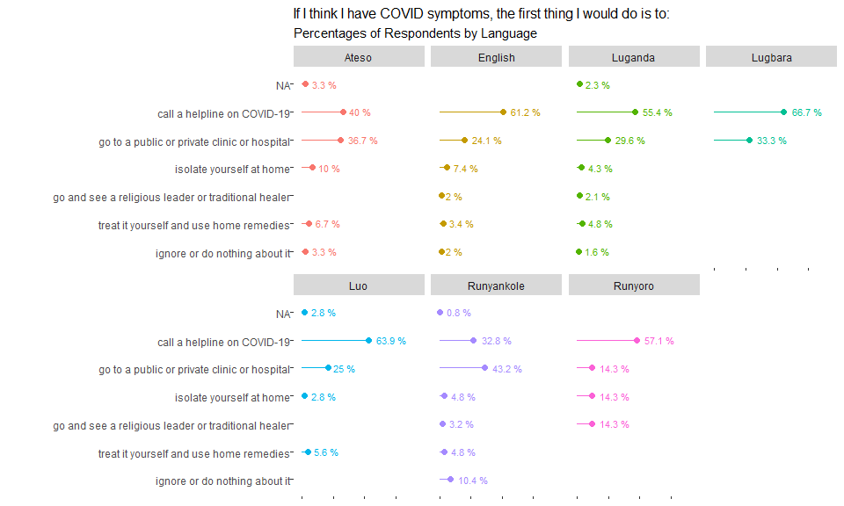
35
UNICEF – for every child

Slide 36
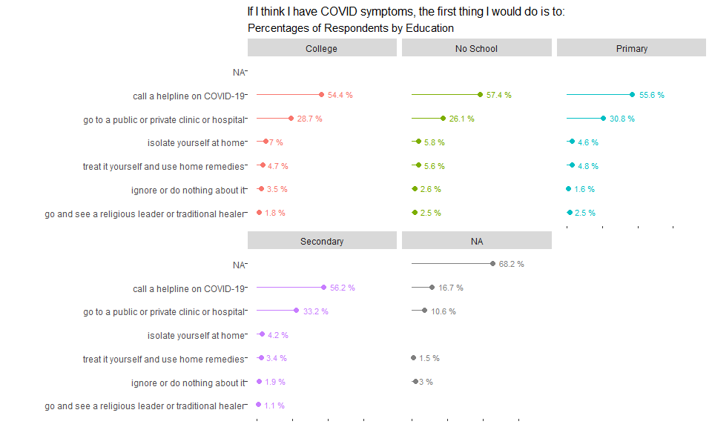
36
UNICEF – for every child

Slide 37
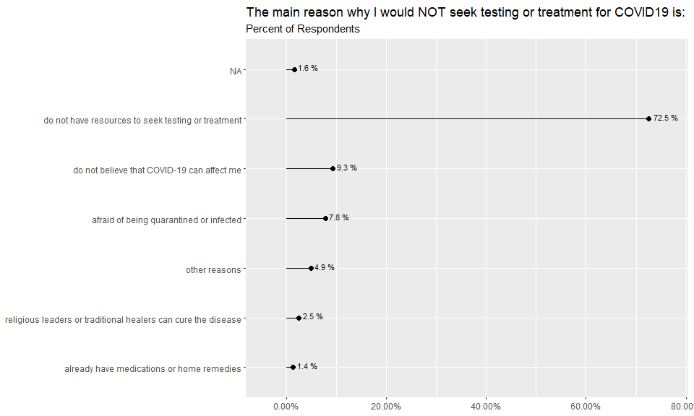
37
UNICEF – for every child

Slide 38
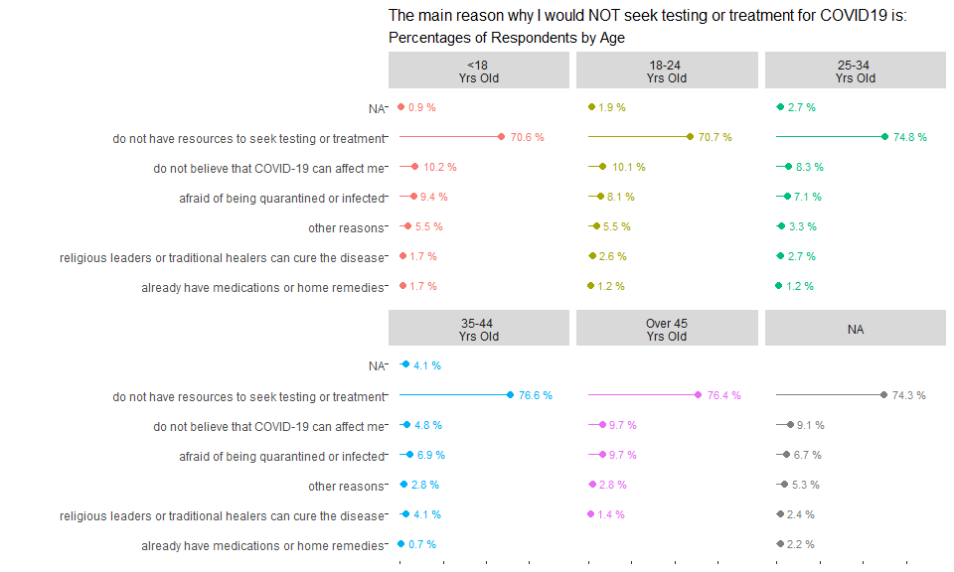
38
UNICEF – for every child

Slide 39
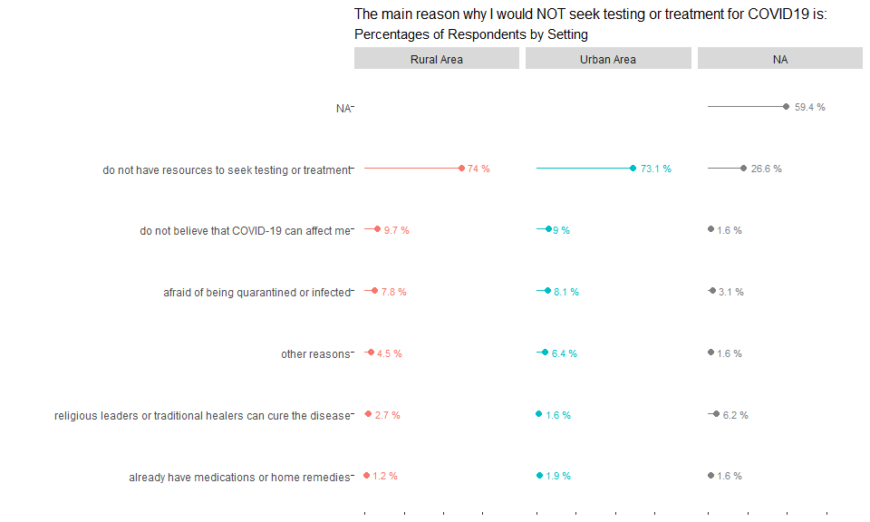
39
UNICEF – for every child

Slide 40
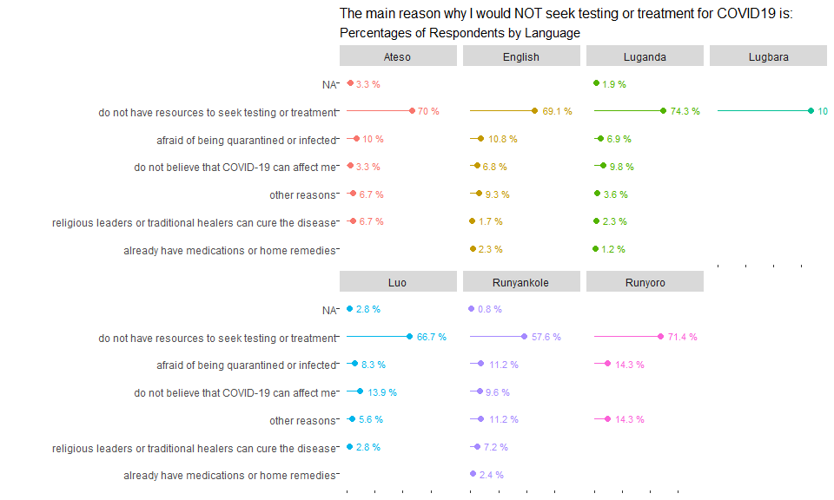
40
UNICEF – for every child

Slide 41
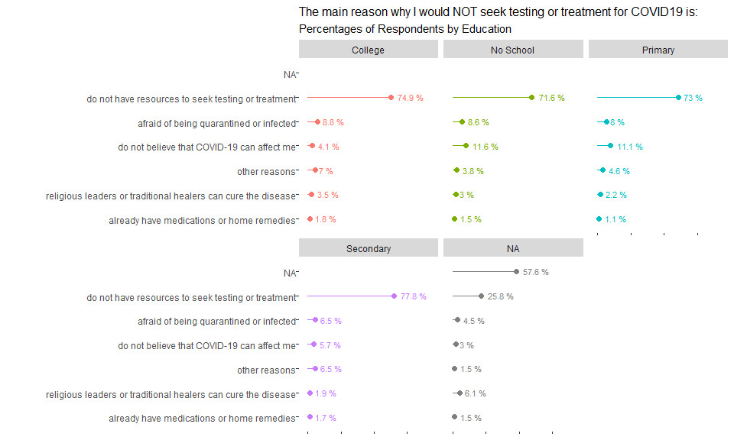
41
UNICEF – for every child

Slide 42
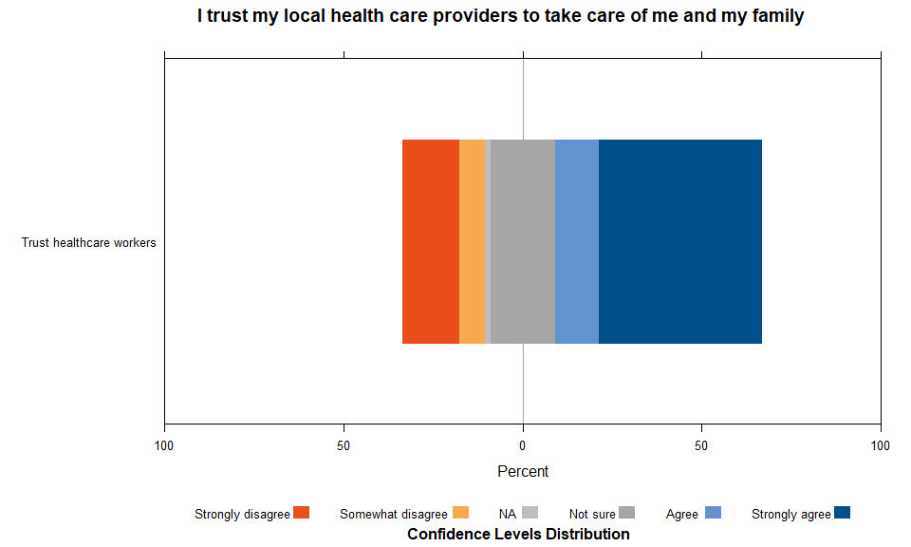
42
UNICEF – for every child

Slide 43
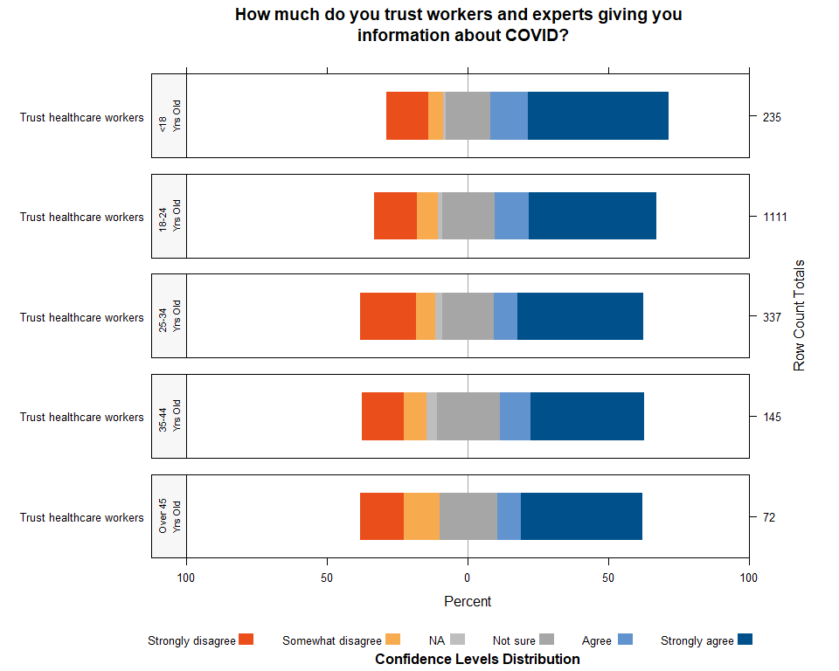
43
UNICEF – for every child

Slide 44
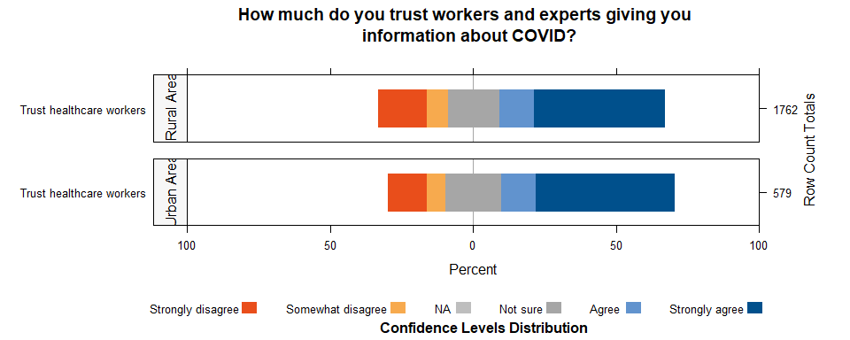
44
UNICEF – for every child

Slide 45
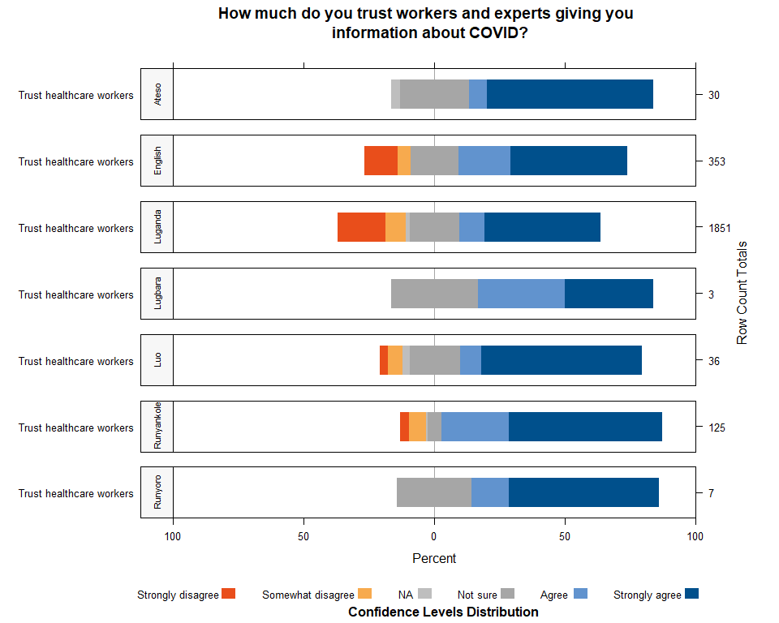
45
UNICEF – for every child

Slide 46
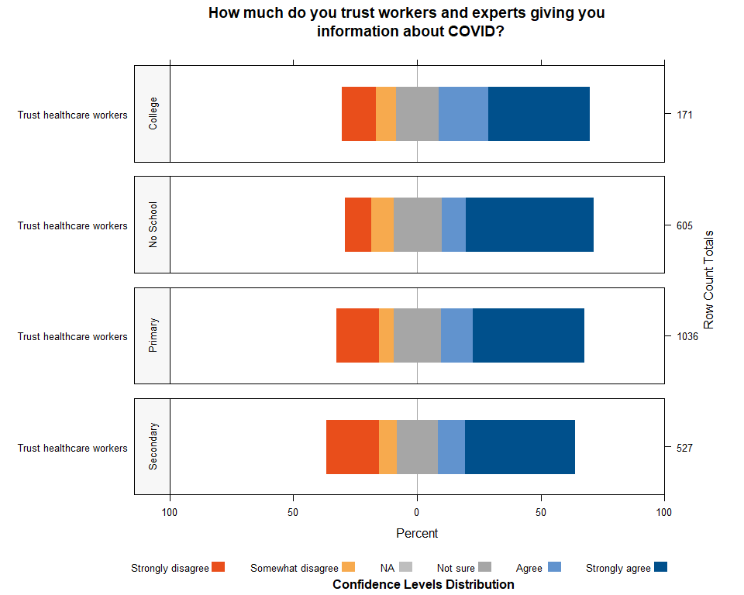
46
UNICEF – for every child

Slide 47
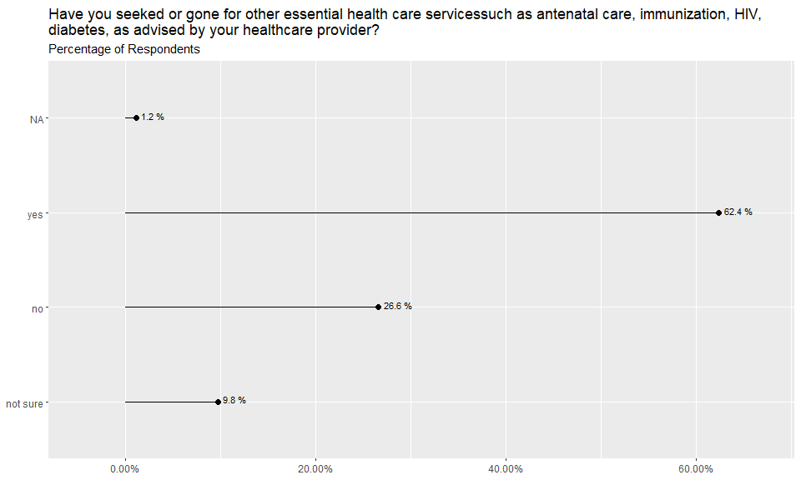
47
UNICEF – for every child

Slide 48
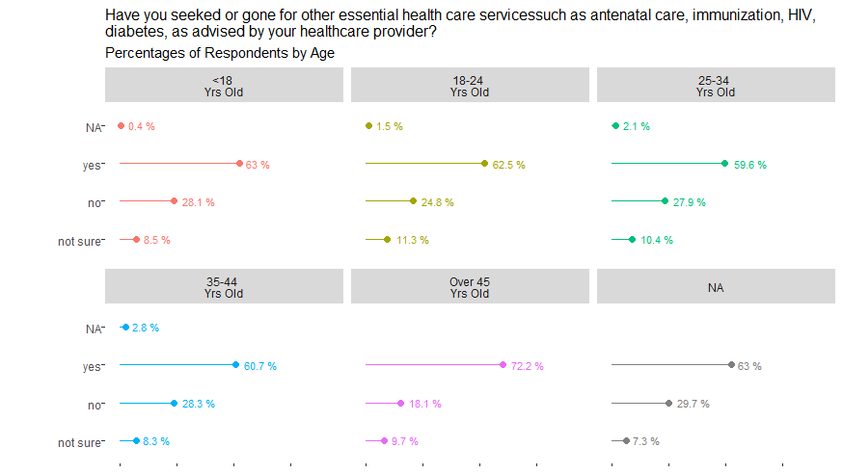
48
UNICEF – for every child

Slide 49
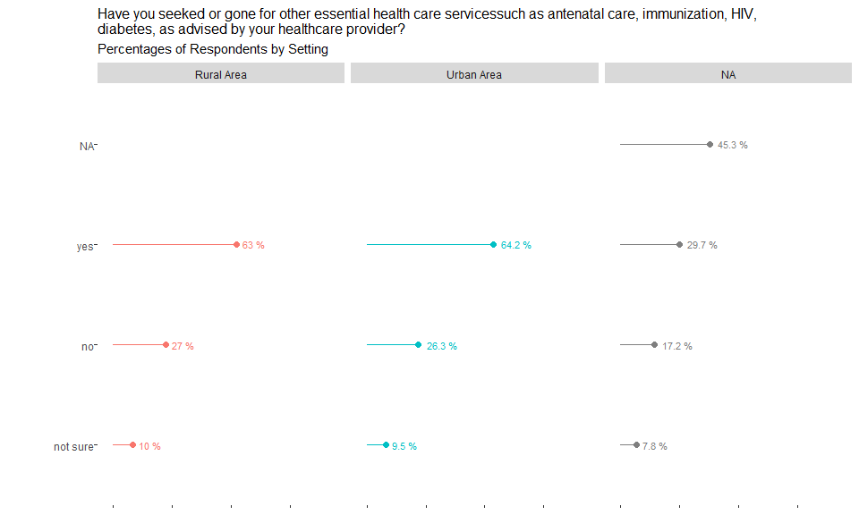
49
UNICEF – for every child

Slide 50
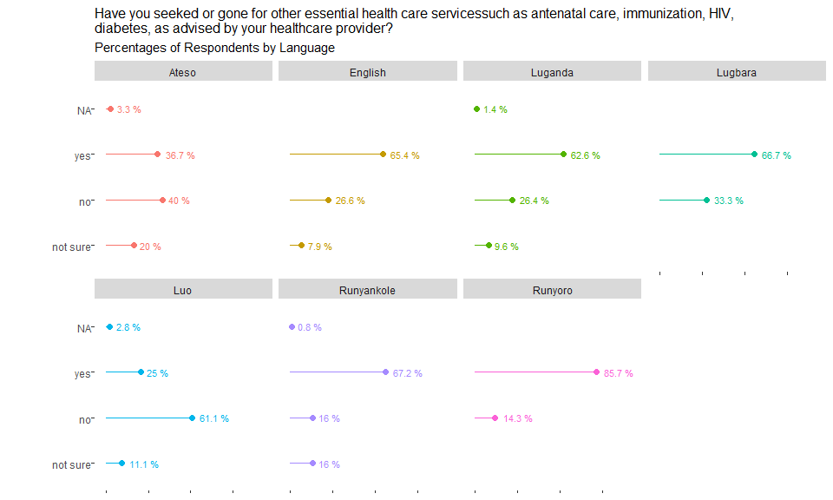
50
UNICEF – for every child

Slide 51
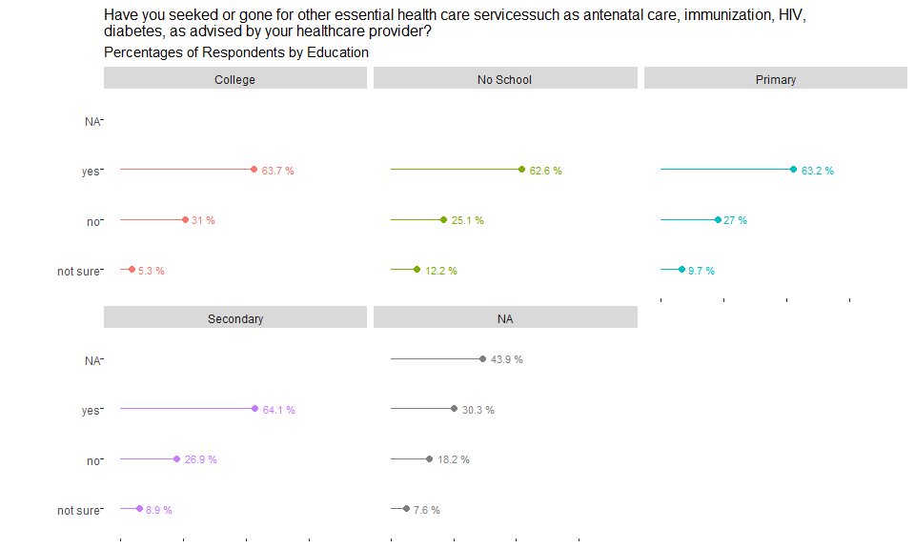
51
UNICEF – for every child

Slide 52

52
UNICEF – for every child

Slide 53

53
UNICEF – for every child

Slide 54

54
UNICEF – for every child

Slide 55

55
UNICEF – for every child

Slide 56

56
UNICEF – for every child

Slide 57

57
UNICEF – for every child

Slide 58

58
UNICEF – for every child

Slide 59

59
UNICEF – for every child

Slide 60

60
UNICEF – for every child

Slide 61

61
UNICEF – for every child

Slide 62

62
UNICEF – for every child

Slide 63

63
UNICEF – for every child

Slide 64

64
UNICEF – for every child

Slide 65

65
UNICEF – for every child

Slide 66

66
UNICEF – for every child

Slide 67

67
UNICEF – for every child

Slide 68

68
UNICEF – for every child

Slide 69

69
UNICEF – for every child

Slide 70

70
UNICEF – for every child

Slide 71

71
UNICEF – for every child

Slide 72

72
UNICEF – for every child

Slide 73

73
UNICEF – for every child

Slide 74

74
UNICEF – for every child

Slide 75

75
UNICEF – for every child

Slide 76

76
UNICEF – for every child

Slide 77

77
UNICEF – for every child

Slide 78

78
UNICEF – for every child

Slide 79

79
UNICEF – for every child

Slide 80

80
UNICEF – for every child

Slide 81

81
UNICEF – for every child

Slide 82

82
UNICEF – for every child

Slide 83

83
UNICEF – for every child

Slide 84

84
UNICEF – for every child

Slide 85

85
UNICEF – for every child

Slide 86

86
UNICEF – for every child

Slide 87

87
UNICEF – for every child

Slide 88

88
UNICEF – for every child

Slide 89

89
UNICEF – for every child

Slide 90

90
UNICEF – for every child

Slide 91

91
UNICEF – for every child

Slide 92

92
UNICEF – for every child

Slide 93

93
UNICEF – for every child

Slide 94

94
UNICEF – for every child

Slide 95

95
UNICEF – for every child

Slide 96

96
UNICEF – for every child

